Slide 1

COVID-19 Vaccine
Twitter Sentiment Analysis Project
Tobias Rodriguez Brindicci
CIS-543

Slide 2
About the project
OBJECTIVE
The goal of this project was to quantitatively analyze the people’s reaction to COVID-19 Vaccine on Twitter and get information on the way they think and feel about it, and what other topics are related to their feelings
DATA COLLECTION
All data has been collected by using the Twitter API and the rtweet package.
I have collected over 200,000 tweets throughout the first week of December 2021.
2

Slide 3
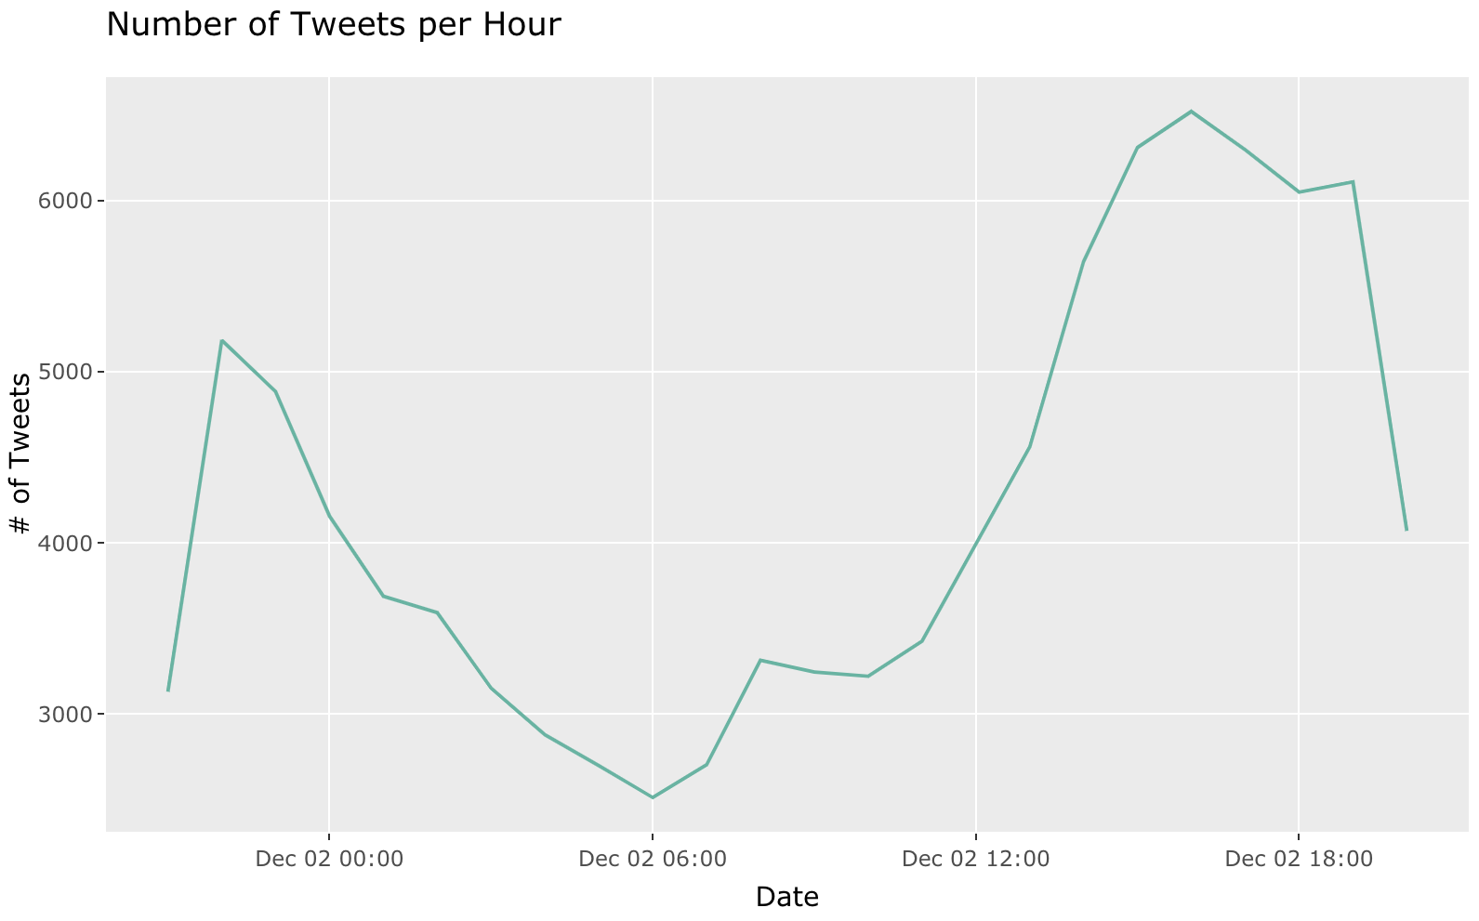
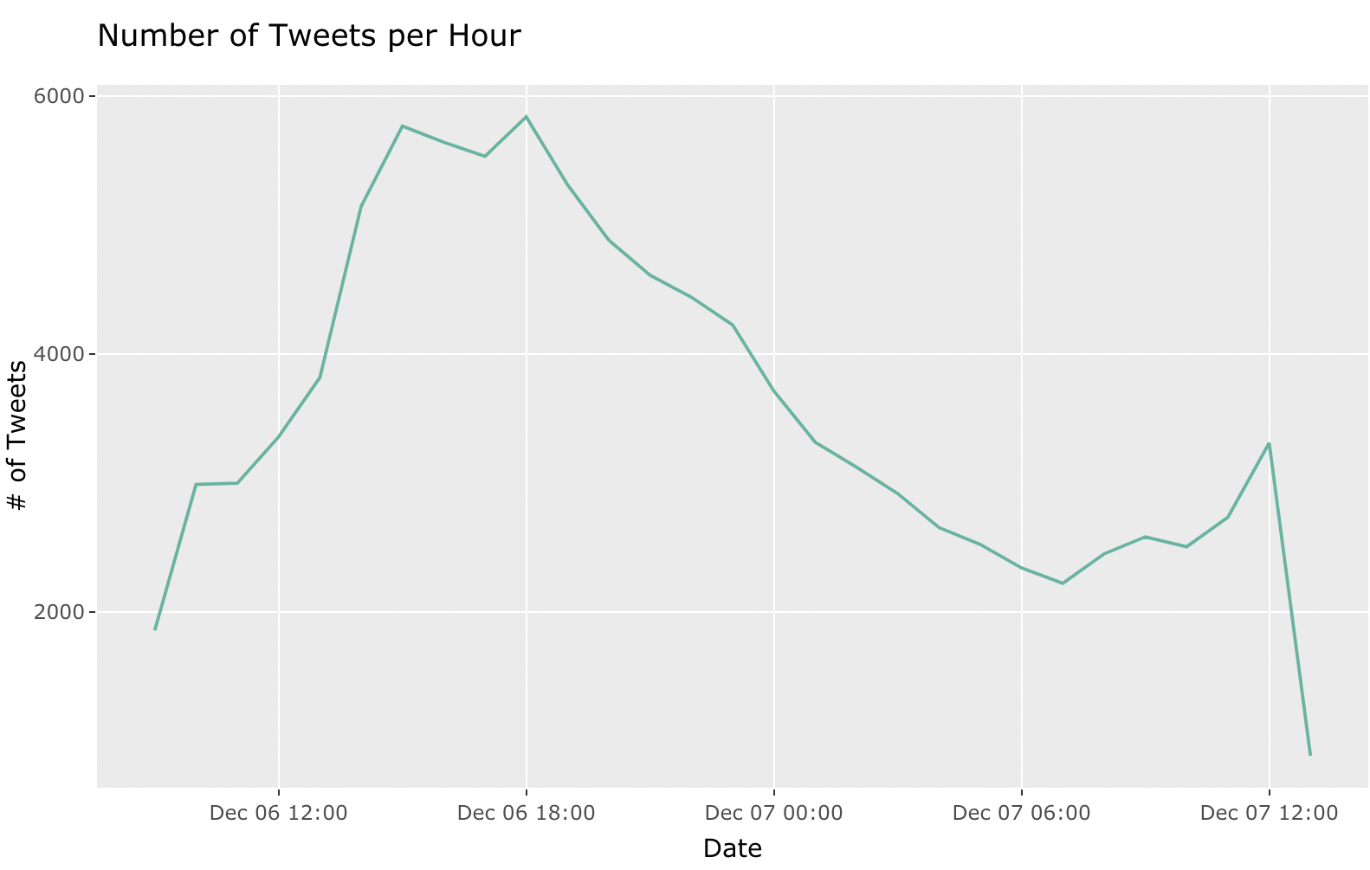
Tweet Traffic
→ At what time people tweet the most about this topic?
→ How many tweets are tweeted every hour?
3

Slide 4
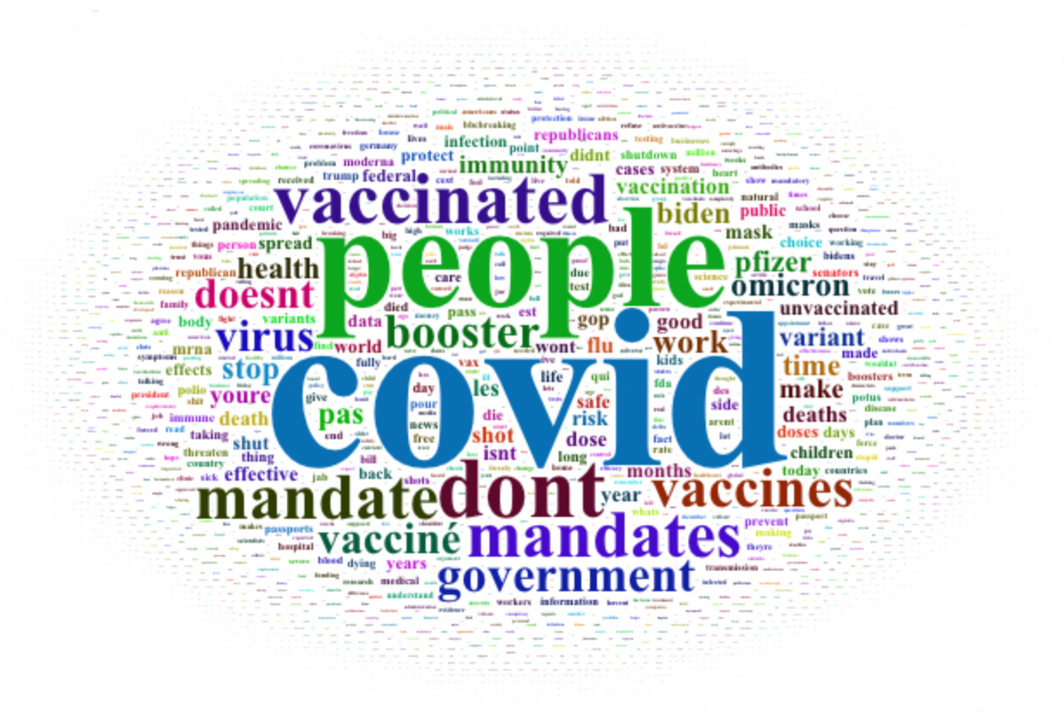
Word Frequency
The FREQUENCY in which a word appears can tell us many things:
→ How often is the word used?
→ What words are typically combined together?
→ What are the most used words to describe certain topic?
Wordcloud for tweets mentioning “vaccine”
4

Slide 5
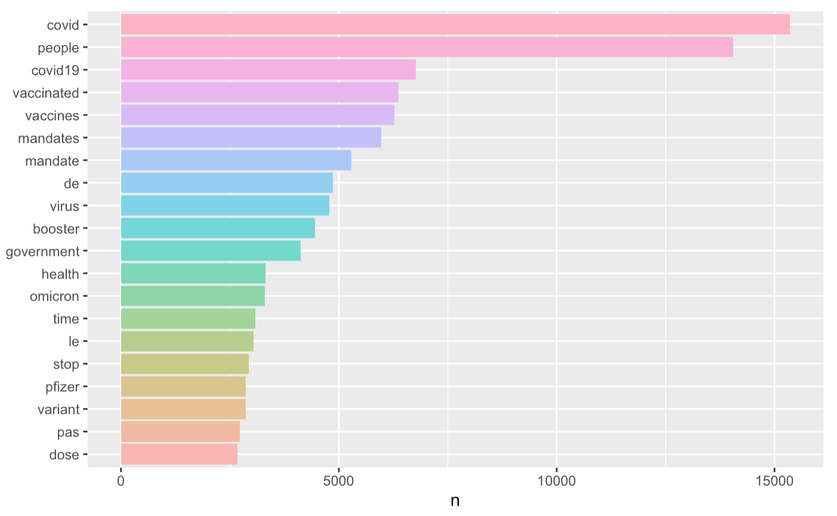
Top 20
Most
Used
Words
5

Slide 6
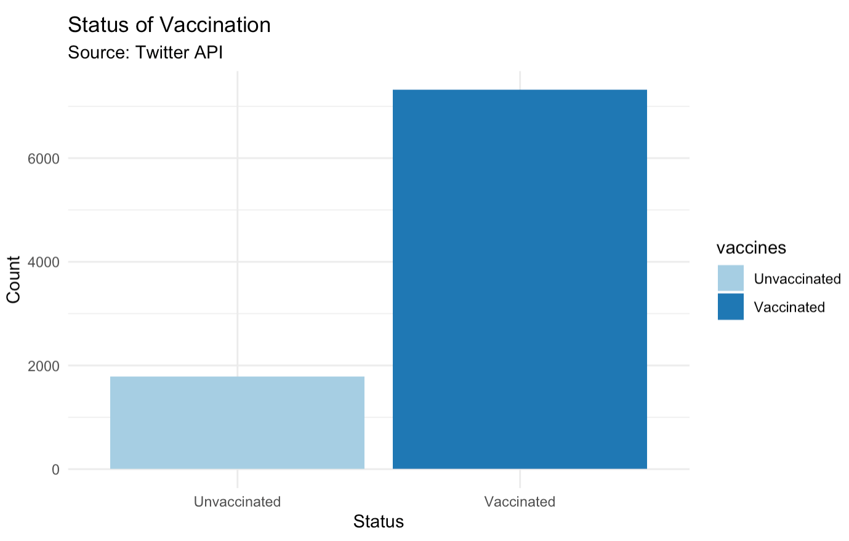
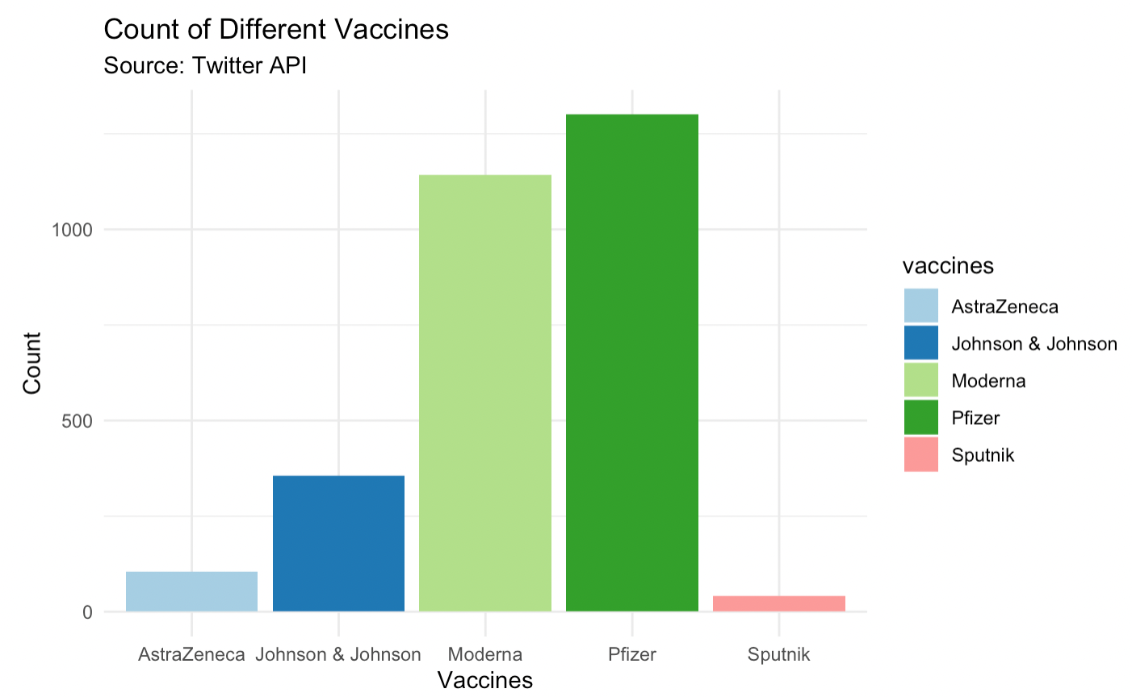
6

Slide 7
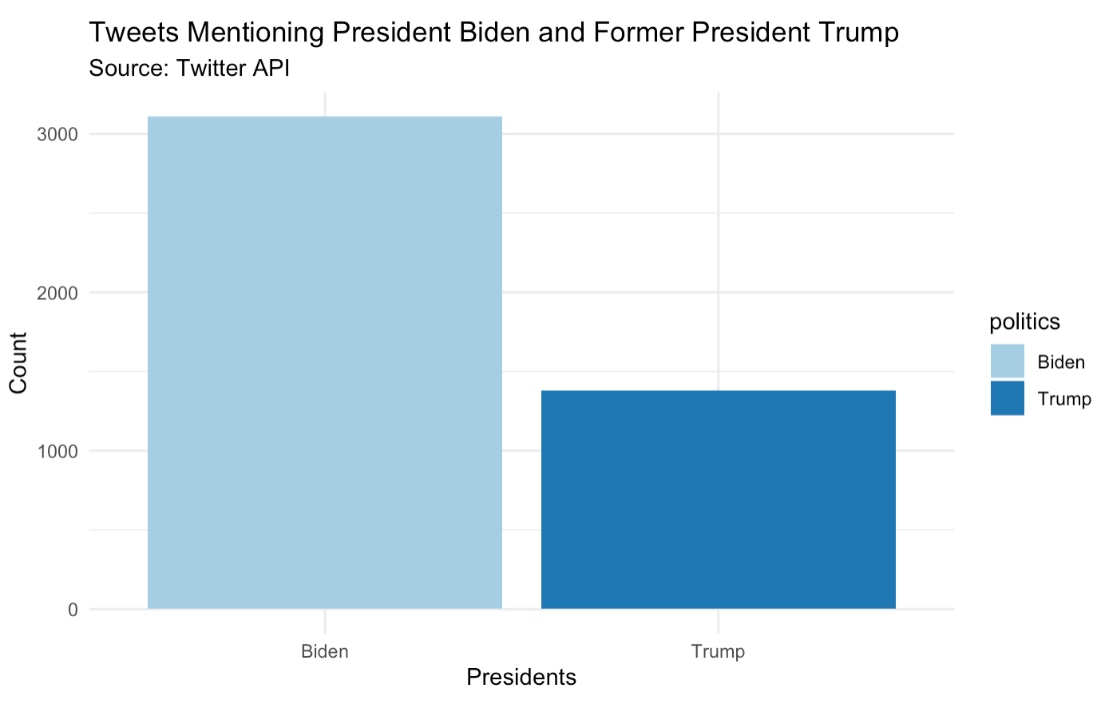
7

Slide 8
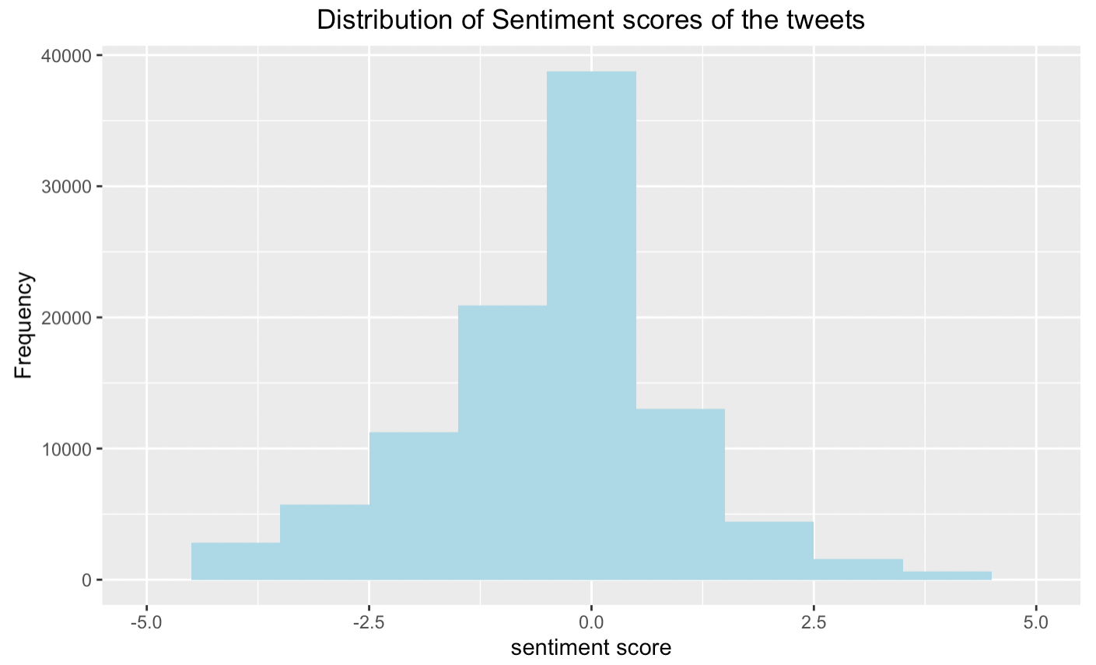
Sentiment Analysis
What is SENTIMENT ANALYSIS?
Sentiment analysis is a natural language processing technique used to determine whether data is positive, negative or neutral.
Each tweet was analyzed word by word in order to see whether the user’s sentiment over the COVID-19 vaccine
8

Slide 9
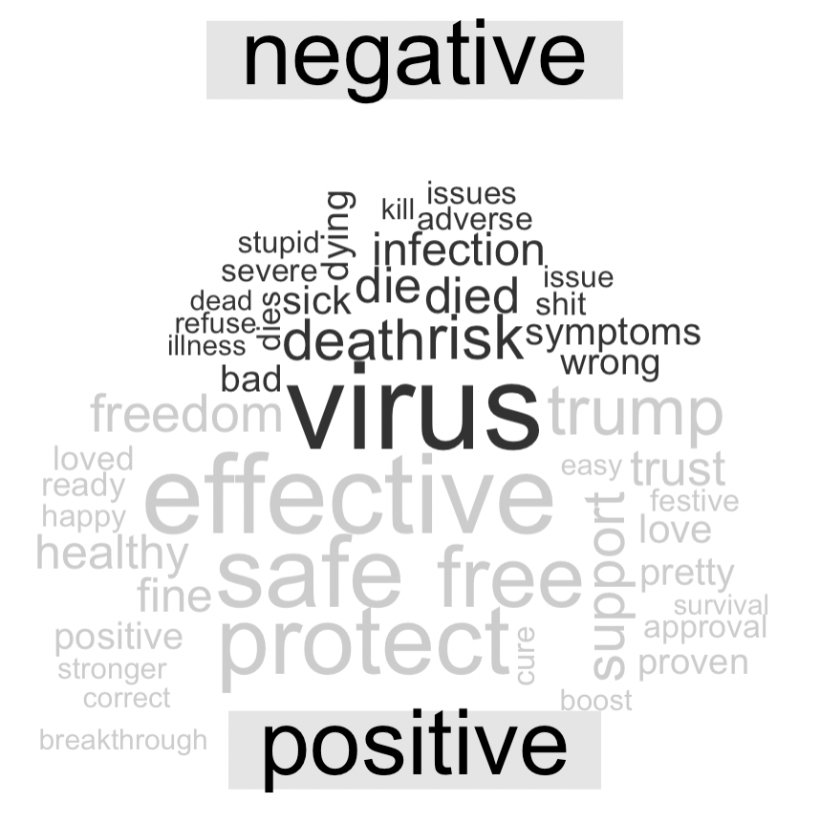
Sentiment Analysis
→ New WORDCLOUD dividing words by sentiment: negative (black), and positive (gray)
9

Slide 10
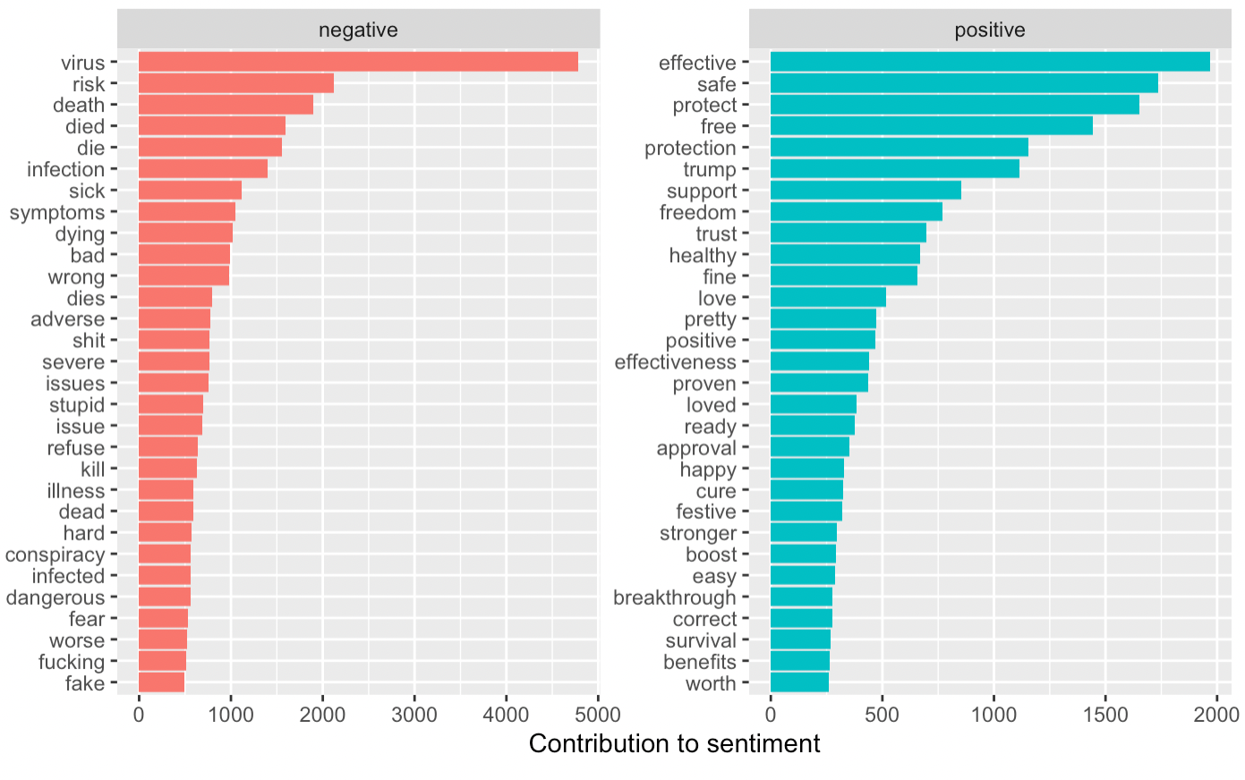
Sentiment Analysis
→ DIVIDING WORDS BY SENTIMENT:
10

Slide 11
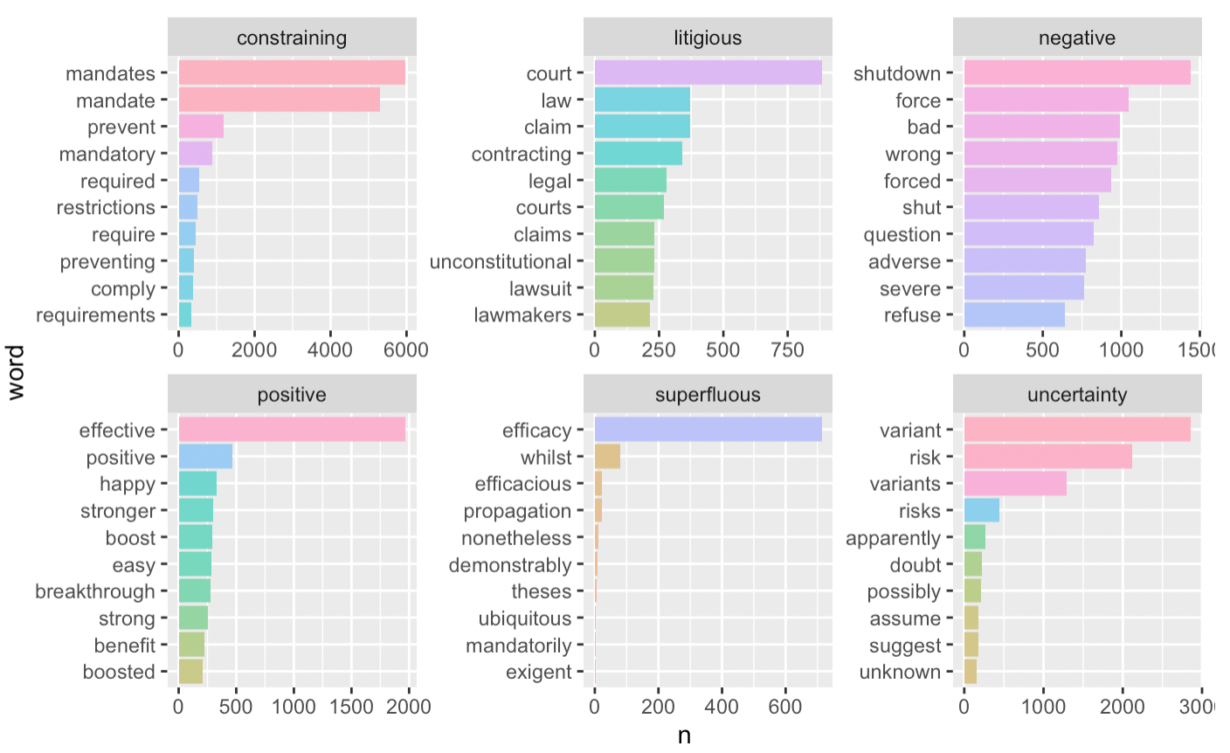
Sentiment Analysis
→ DIVIDING WORDS BY SENTIMENT:
11

Slide 12
THANK YOU
12

